Slide 1
Indiaaaaaaaaaaaaa
Most populous country
Most Indians are Hindu
Most, if not all, speak Hindi and English fluently
The geography is so big that it is considered a subcontinent
Every single climate is possible in its borders
By - Madhavan And Leo

Slide 2
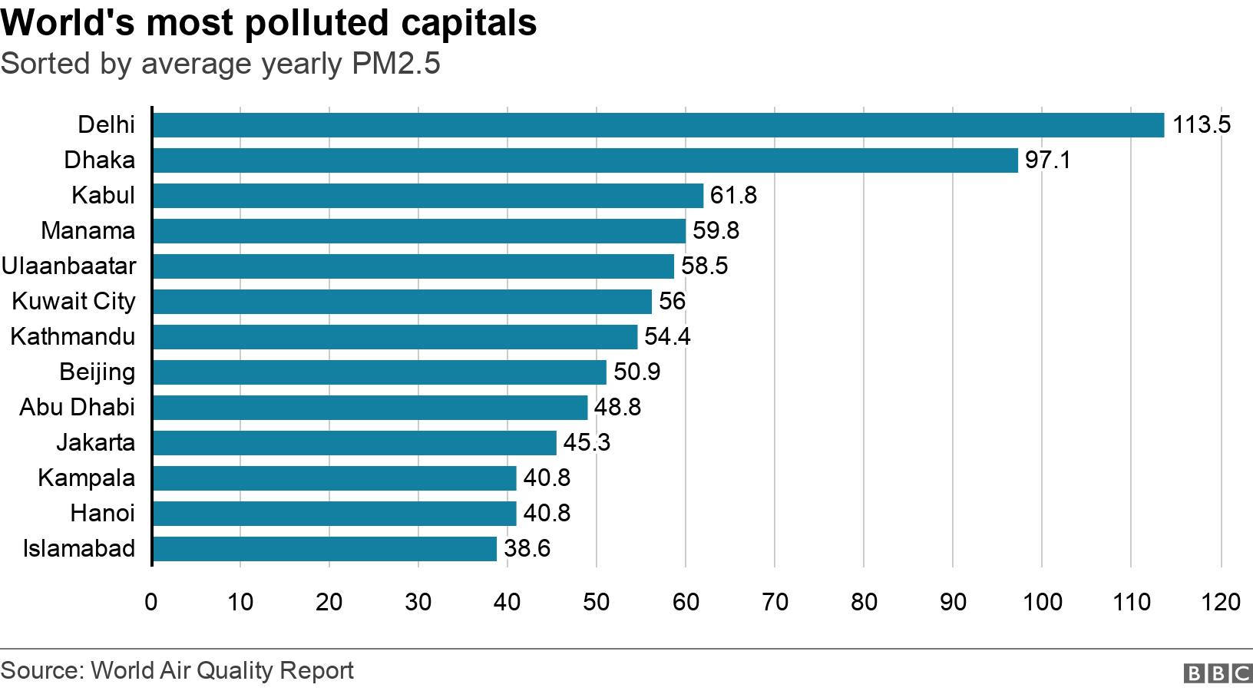
The issue that is going on in India and has been going on for a long time is Air Pollution and Public Health and this matters a lot to other countries, especially to its direct neighbors because the pollution can spread and has spread. This can and majorly has also impacted human lives and taken them in the process.
Air Pollution And Public Health
Citations : .

Slide 3
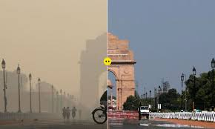
India has done things to fight air pollution by launching a nationwide limit on how much air pollution industrialists can cause and enforcing that starting in 1981. Next, they have tried to completely halt sulphur emissions and convert all their vehicles to be electric instead of gas powered.
The Response
Citations : .

Slide 4

Many people have noticed that trying to reduce pollution in some of these more populated and more polluted cities leaves the towns, villages, rural areas, and more over the less populated and less polluted areas to be almost completely ungoverned. And the polluted areas lead to bans on certain things like construction work for a certain amount of time, or closure of schools for such, but that leads to millions being stranded with no way of making money got the time being.
The Consequences
Citations : .

Slide 5
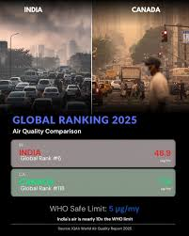
Yes, this is very similar to the Canadian way of doing things, using a tiered prioritization system, leading to more polluted areas being dealt with first. Plus the fact that both have to use many methods to control the smoke that rises every year, be it crop stubble burning in India in the winter, or wildfires in Canada more during the summertime, this drives up the seasonal rate of air pollution by a lot.
Does Canada do This?

Slide 6
The reason that India has these air pollution problems is because of the fact that the people don't comply. Canada’s air pollution stems from a different reason, one of the environment, of nature. If Canada can’t realize that even though the smoke is not their, it’s THERE, they will always have smoke problems, just like India is having problems with trying to figure out which state is responsible for the crop stubble burning even though they should be trying to mitigate the process. WHO doesn’t matter in this situation, it’s the “HOW do we get rid of this” that matters.
Why the hell should Canada care?

Slide 7
Balakrishnan, K., Dey, S., Gupta, T., Dhaliwal, R. S., Brauer, M., Cohen, A. J., Stanaway, J. D., Beig, G., Joshi, T. K., Aggarwal, A. N., Sabde, Y., Sadhu, H., Frostad, J., Causey, K., Godwin, W., Shukla, D. K., Kumar, G. A., Varghese, C. M., Muraleedharan, P., . . . Dandona, L. (2018). The impact of air pollution on deaths, disease burden, and life expectancy across the states of India: the Global Burden of Disease Study 2017. The Lancet Planetary Health, 3(1), e26–e39. https://doi.org/10.1016/s2542-5196(18)30261-4

Slide 8
Sharma, D., & Mauzerall, D. (2021). Analysis of Air Pollution Data in India between 2015 and 2019. Aerosol and Air Quality Research, 22(2), 210204. https://doi.org/10.4209/aaqr.210204

Slide 9
Ministry of Environment, Forest and Climate Change. (2025). National Clean Air Programme (NCAP): Progress report and fund utilization for non-attainment cities (Unstarred Question No. 1422). Rajya Sabha, Parliament of India.

